Slide 1
Design Erasmus+
Aleksandra

Slide 2
Hi,my name is Ola. I am a student of the seventh grade of primary school. I’m 12 years old and I am from Poland.

Slide 3
I live near Warsaw (it is capital of the country) in the commune of Stare Babice. Next to my house there are three more houses where lives my family.

Slide 4
As for my appearance, I am about 160 centimeters. I am quite slim. I have long brown hair which are starting to spin. My eyes are quite small and they are dark blue – gray.

Slide 5
Regarding to my character I am very emotional which entails being explosive. I am also ambitious, self-critical and exact.

Slide 6
But most of all I am tolerant, honest and brave. I could never watch the other peron suffer.
I think I have this trait from my mother, she is very good human

Slide 7
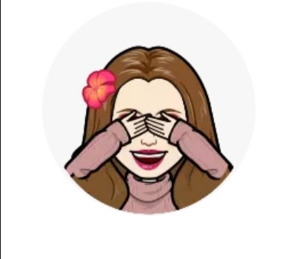
I like to spend my free time with my nephews (my cousins sisters are much older than me) and my younger brother.
I love hanging out with my friends outside of school.

Slide 8
I love dance and acrobatic gymnastic. I really like playing basketball, especially with my friends.

Slide 9
Thanks for reading the description about me.

