Slide 1
GERARD STACHELEK

Slide 2
Hi i am Gerard.
I am twelve years old.
I live with my parents, brother and two sisters in a small village, Koczargi Stare, in Poland.

Slide 3
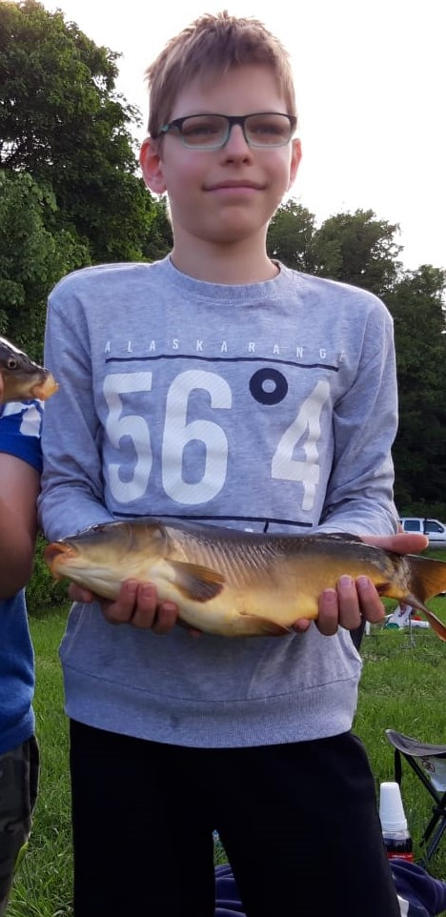
I have blue eyes and blond hair.
I am thin and rather short.
I wear blue and black glasess.

Slide 4
My dad is a computer scientist and mum does chores at home.
I have got two gerbils and my brother has got fish.
We used to have a parrot too but it has recently gone away.

Slide 5
I like playing football, fishing and collecting muchrooms.
At weekends I read books or play computer games.
I often go to my friends too or chat online with them.

Slide 6
I don’t like eating chocolate, cakes, chips and ice cream.
My favourite food is pizza and pancakes.
I can cook them by myself.

Slide 7
Sometimes I help my mum in her workes in the garden beacuse I love plants.
However, I hate doing hause chores such as tiding my room or washing the dishes.
Instead of this, I’d like to build Lego blocks or watch once again my favourite film Emotes.

Slide 8
Thanks for your time!

