Slide 1
Presentation about myself
Jacob W.

Slide 2
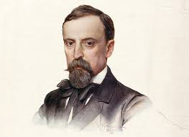
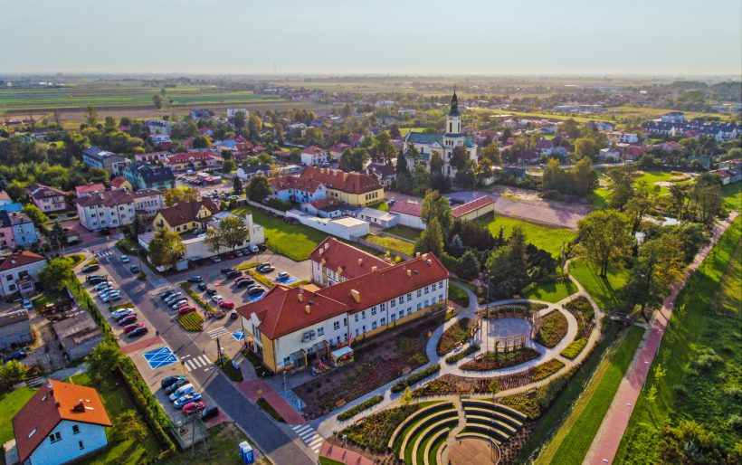
About Me
I’m Jacob and I am13 years old. I live in a semi-detached house in a small village, Stare Babice. I’m in the seventh grade in the Primary School named of Henryk Sienkiewicz, a very famous Polish novelist. It’s located in Stare Babice.

Slide 3
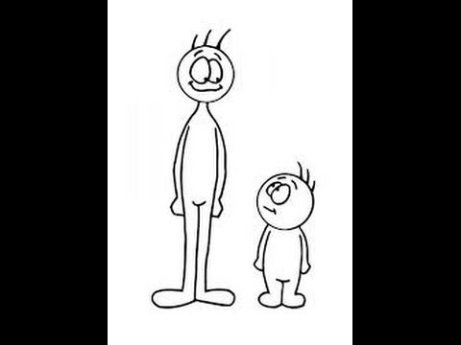
My apperance
I’m a medium high boy, but when I stay next to my friends I feel like a little boy. My friends are very tall. I'm a slim and well-built person. I have a little bit of a dark complexion. I've got tall legs and arms, tiny brown eyes and small, normal nose. I have fair, straight hair and lots of moles.

Slide 4
My character
I’m an ambitious, clever, creative, sociable, loyal person. I’m always friendly to other people, but when they rile me, I’m changing to mean person for him. I’m opened for new ideas and new people. When someone is sad or something happened I always help him.

Slide 5
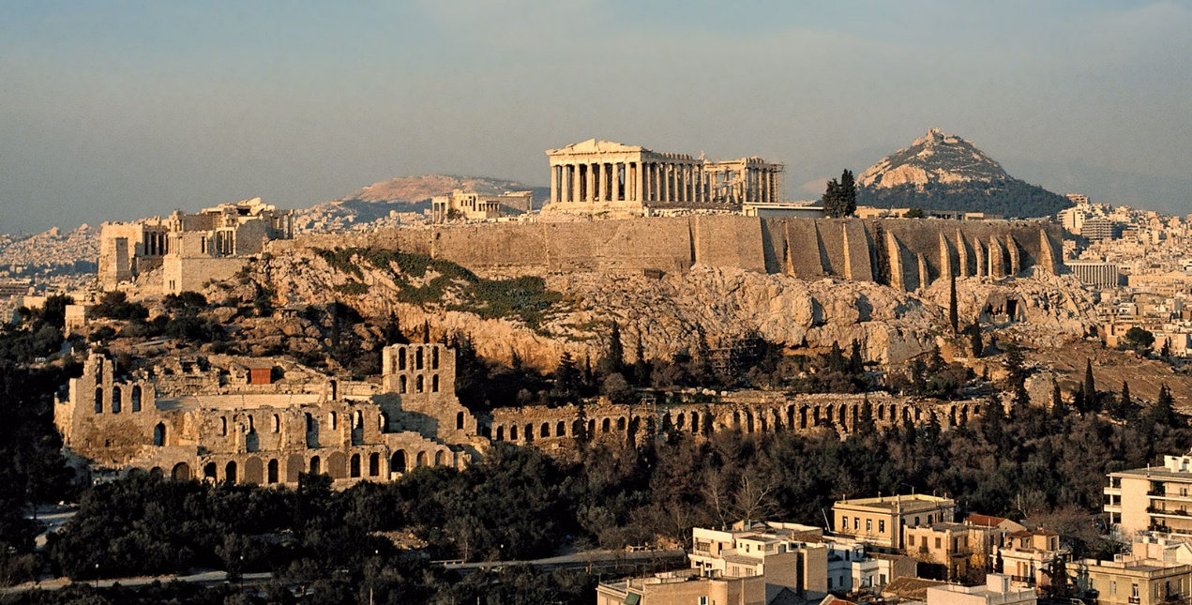
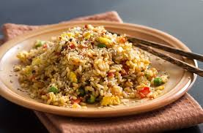
My hobbies
I like playing sports like football, basketball, volleyball, tennis and more activities. I like playing computer games too. I’m good at it! I also like adventures. I like travelling to other countries and meeting new cultures, traditions, their monuments and trying regional kitchen.

Slide 6
THE END!
THANK YOU FOR YOUR ATTENTION!

